Slide 2
47 YEARS OF UNIVERSITY’S HISTORY

Slide 3
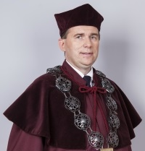
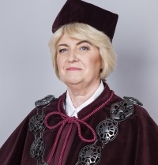
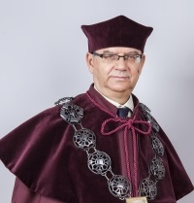
UNIVERSITY’S AUTHORITIES
RECTOR
prof. dr hab. Anna Wypych – Gawrońska
VICE – RECTOR FOR RESEARCH AND INTERNATIONAL RELATIONS
dr hab. Janusz Kapuśniak, prof. UJD
VICE – RECTOR FOR STUDENT AFFAIRS
dr hab. Grażyna Rygał, prof. UJD
VICE – RECTOR FOR UNIVERSITY DEVELOPMENT
dr hab. Inż., Zygmunt Bąk, prof. UJD

Slide 4
ASSETS AND ACHIEVEMENTS
is the leading University in the region
has highly qualified academic staff
the staff’s academic achievements result in modern solutions and innovations, new technologies and patents
implements and popularizes new teaching methods
cooperates with several dozen foreign universities around the world
has its own library, publishing house, sports centre, modern infrastructure, dormitory, planetarium, laboratories

Slide 5
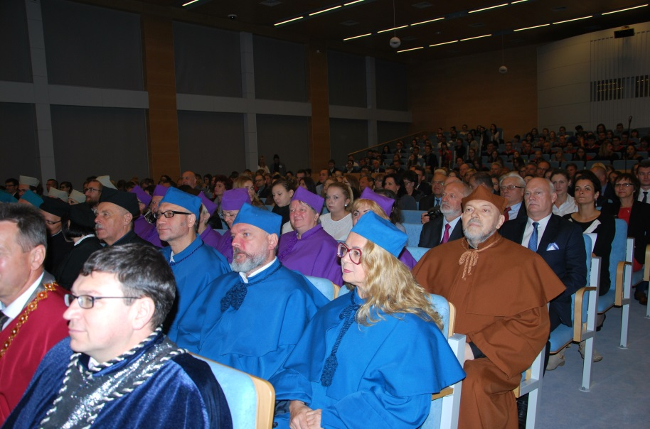
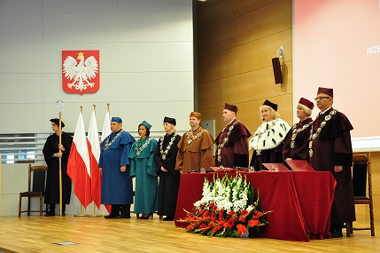
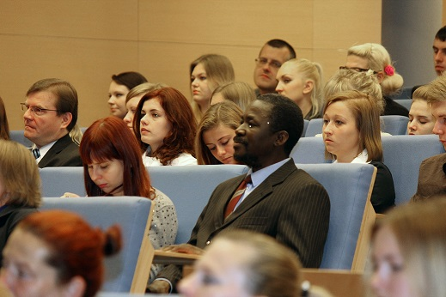
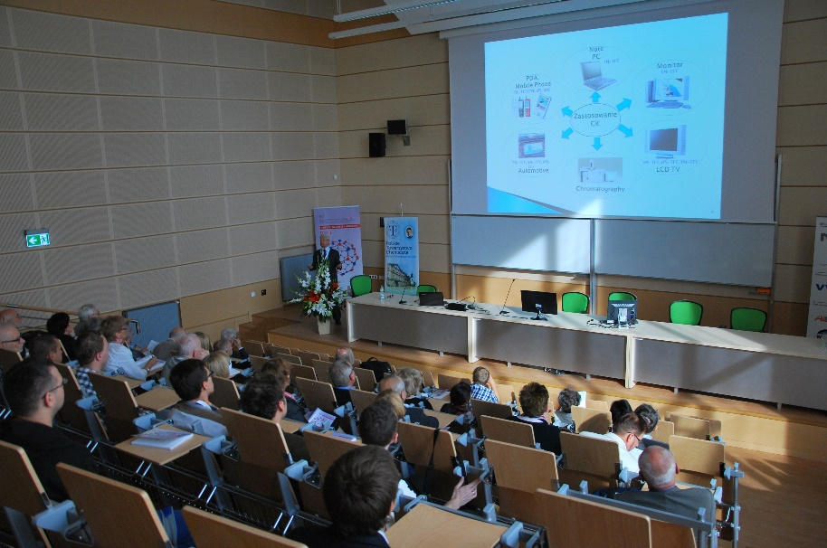
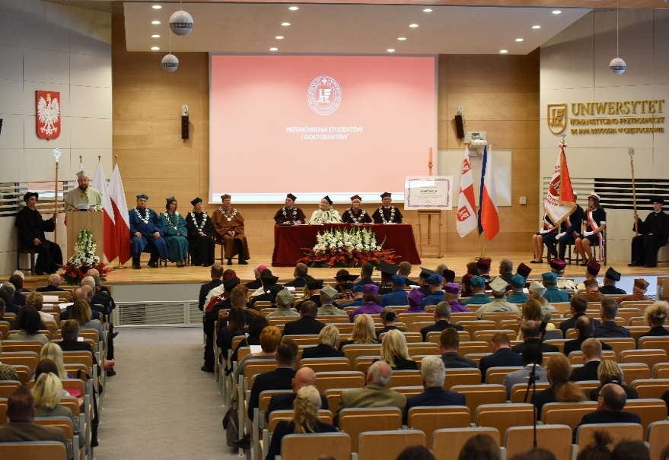
STRUCTURE AND STAFF

Slide 6
STRUCTURE

Slide 7
STAFF

Slide 8
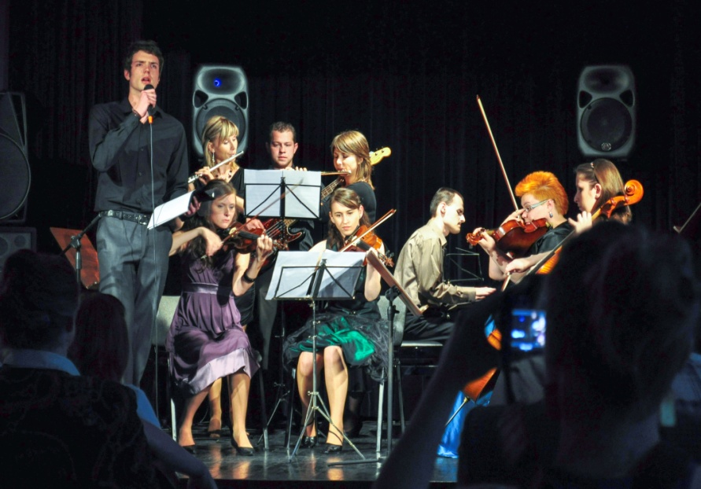
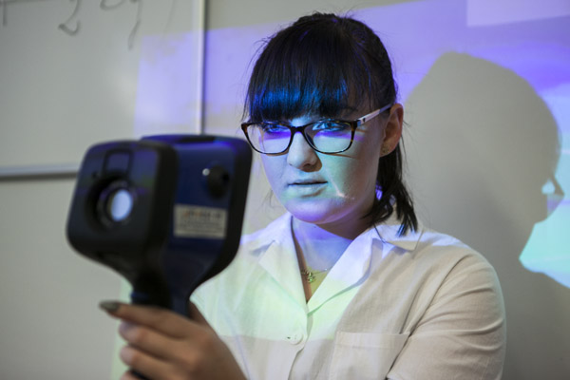
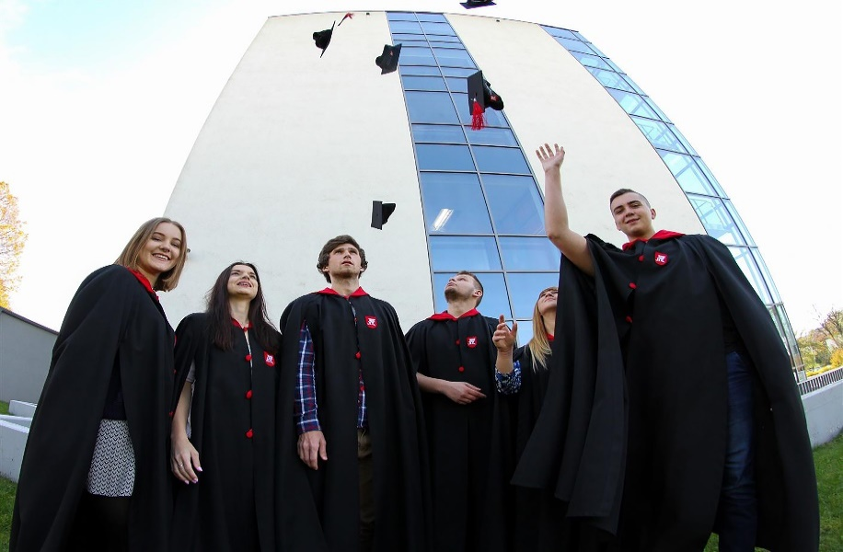
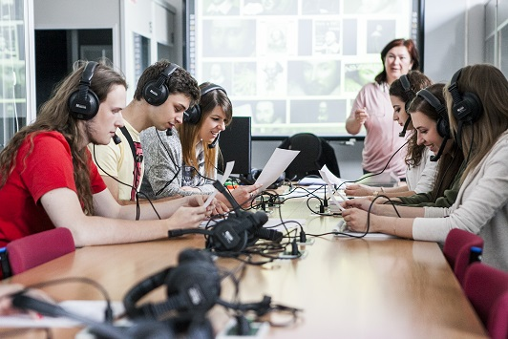
TEACHING ACTIVITIES

Slide 9
TEACHING ACTIVITIES

Slide 10
TEACHING ACTIVITIES

Slide 11
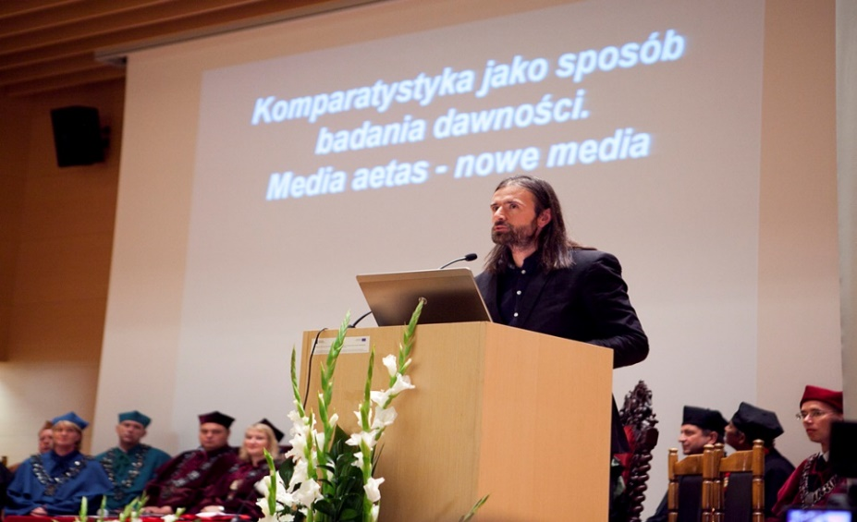
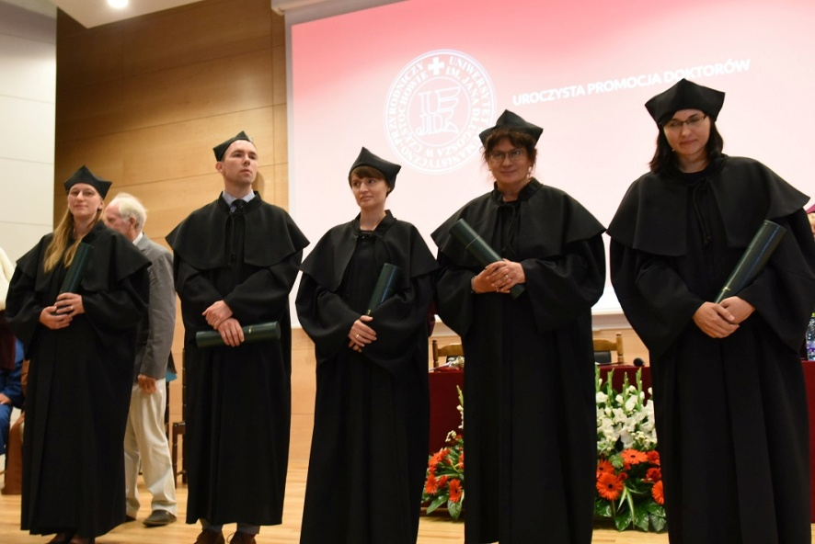
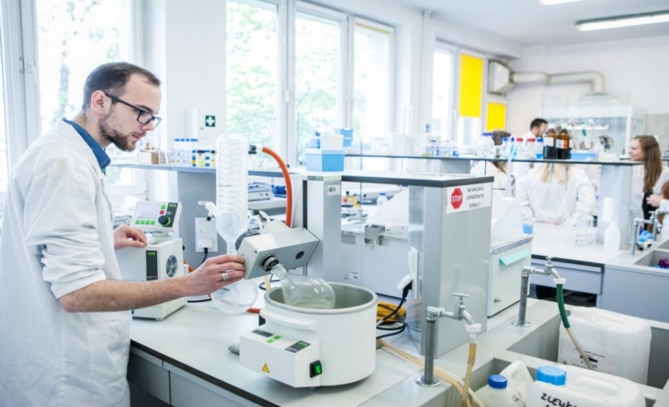
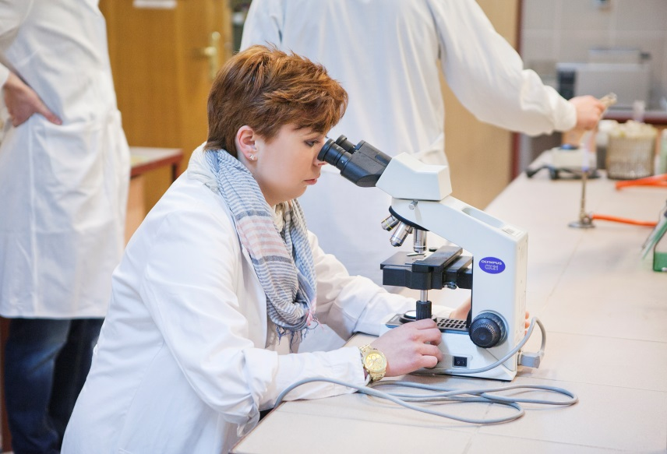
SCIENTIFIC ACTIVITIES

Slide 12
SCIENTIFIC ACTIVITIES

Slide 13
SCIENTIFIC ACTIVITIES

Slide 14
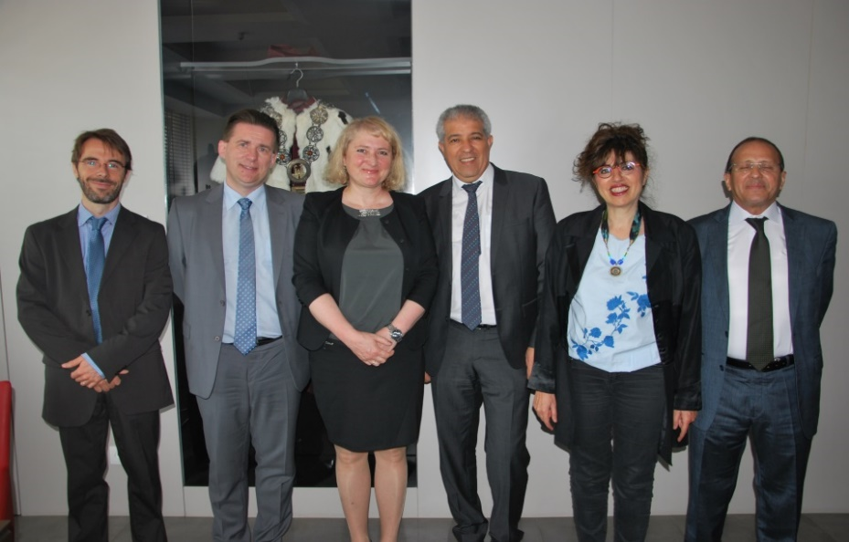
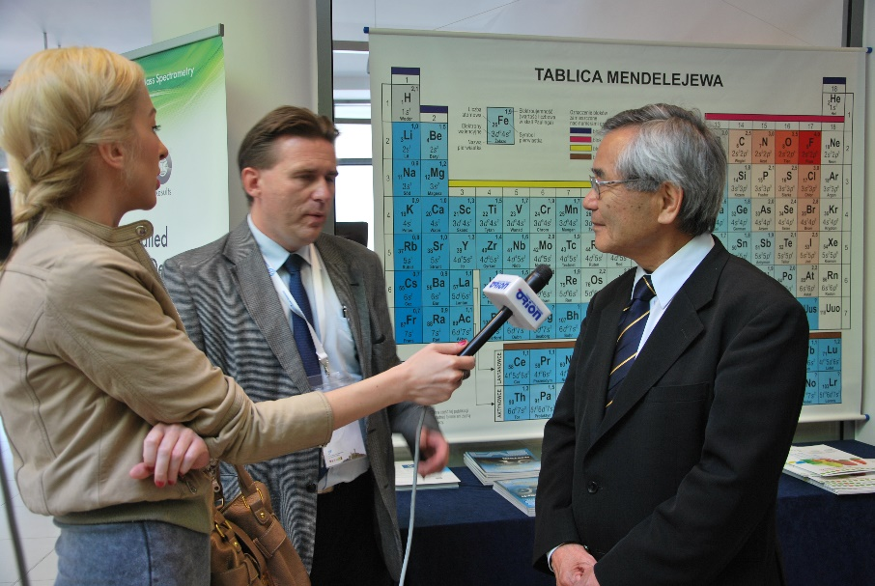
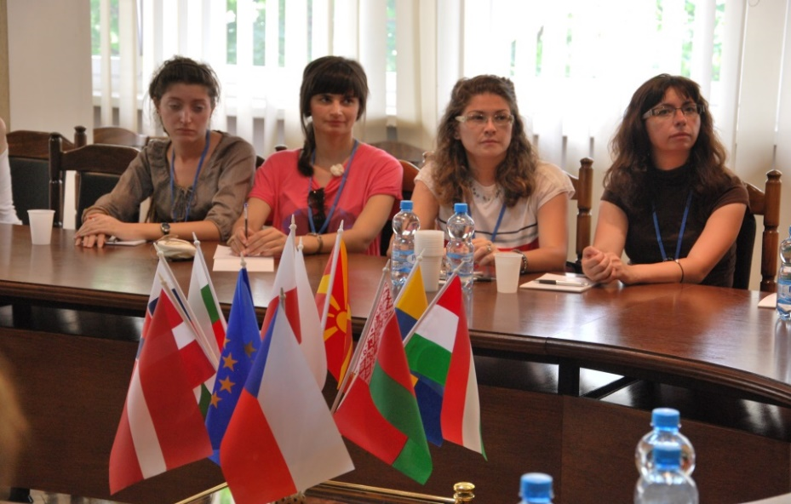
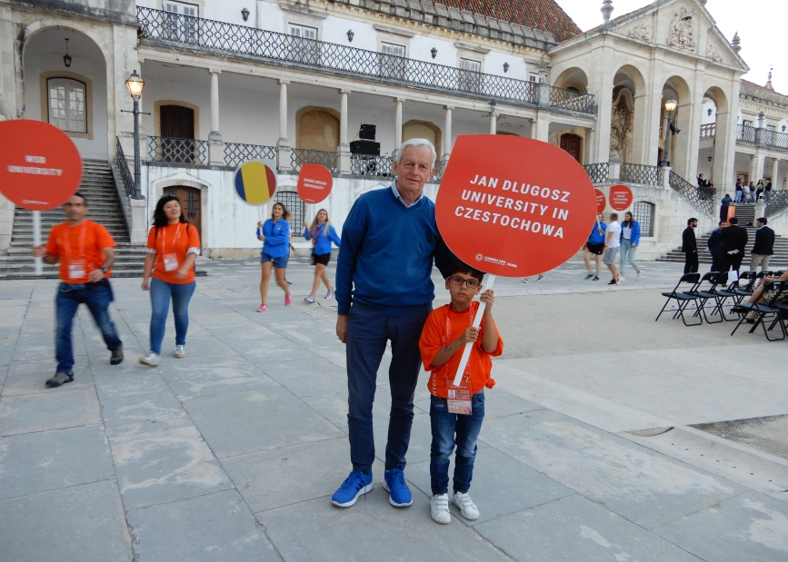
INTERNATIONAL COOPERATION

Slide 15
INTERNATIONAL COOPERATION
Nearly 120 cooperation agreements with foreign institutions, including more than 50 inter-institutional agreements within Erasmus+ program
Partner institutions from nearly 30 countries
Nearly 450 non-natives hosted at JDU yearly; half of them are students
Around 100 people, employees and students, go abroad by means of Erasmus program every year
Around 40 people, employees and students, come to JDU by means of Erasmus+ program every year
Participation in international exchange programs: Erasmus+ KA103, Erasmus+ KA107, PROM, CEEPUS

Slide 16
INTERNATIONAL EXCHANGE OF STAFF

Slide 17
INTERNATIONAL EXCHANGE OF STAFF

Slide 18
INTERNATIONAL AGREEMENTS

Slide 19
INTERNATIONAL PROJECTS

Slide 20
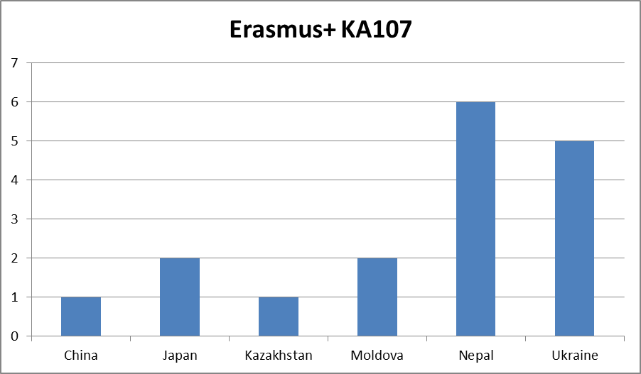
INTERNATIONAL PROJECTS

Slide 21
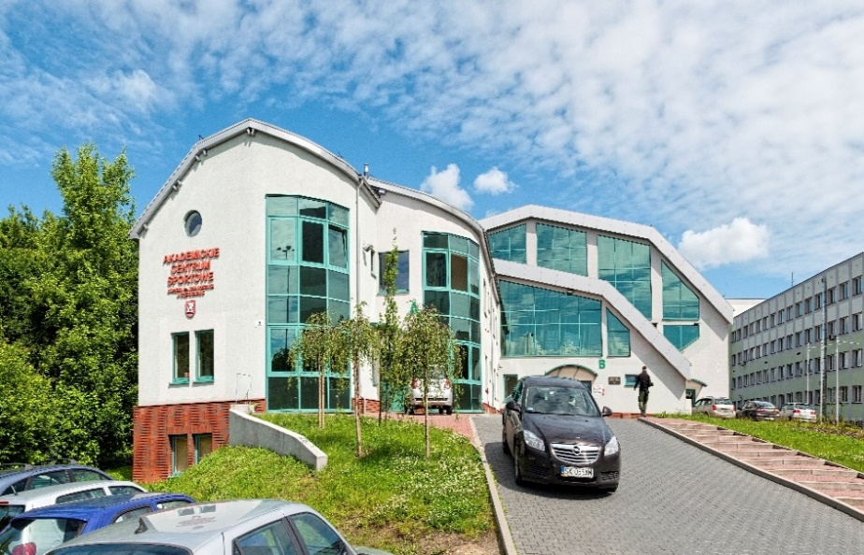
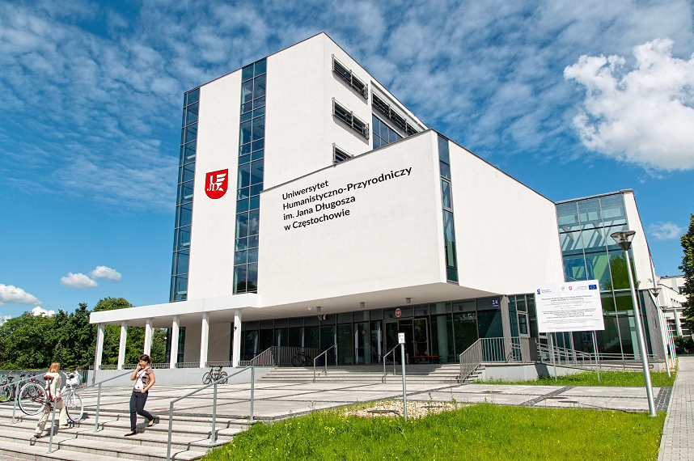
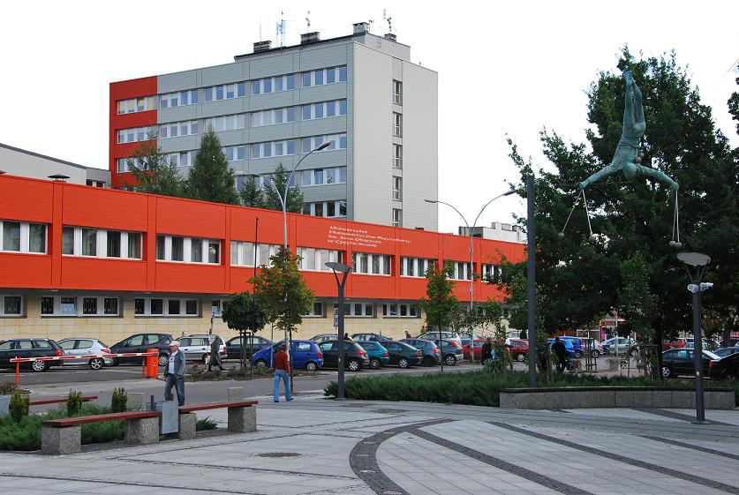
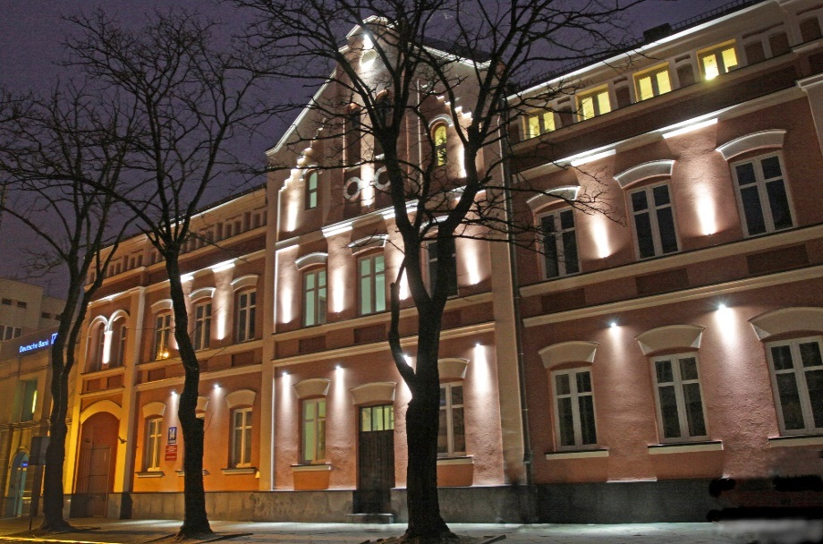
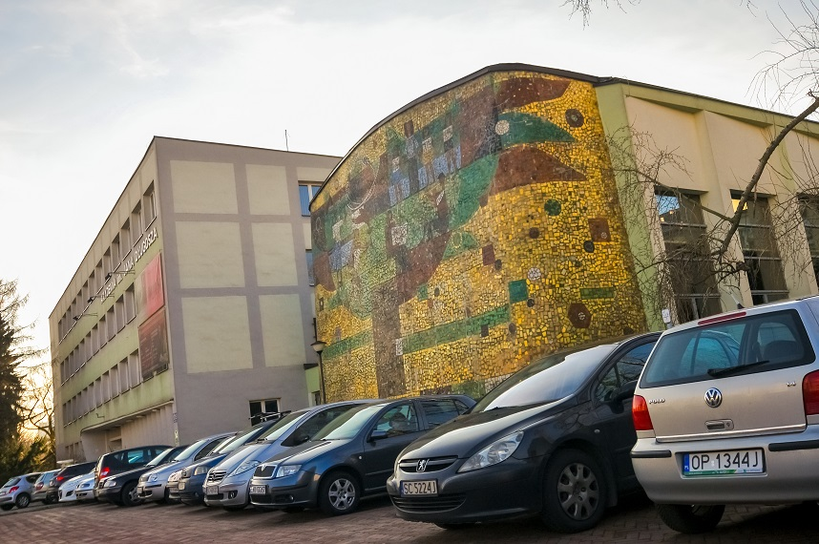
INFRASTRUCTURE

Slide 22
UNIVERSITY FACILITIES

Slide 23
DEVELOPMENT AND INVESTEMENT

Slide 24
Contact us
Jan Dlugosz University im Czestochowa
Department for Research & International Relations
Waszyngtona 4/8, 42-200 Częstochowa
tel. 34 37 84 272 (English, Deutsch)
tel. 34 37 84 364 (English)
fax: 34 37 84 368
e-mail: international@ujd.edu.pl

